Slide 1
Twitter Sentiment Analysis of Tweets about COVID-19 vaccine
Sameer Neupane

Slide 2
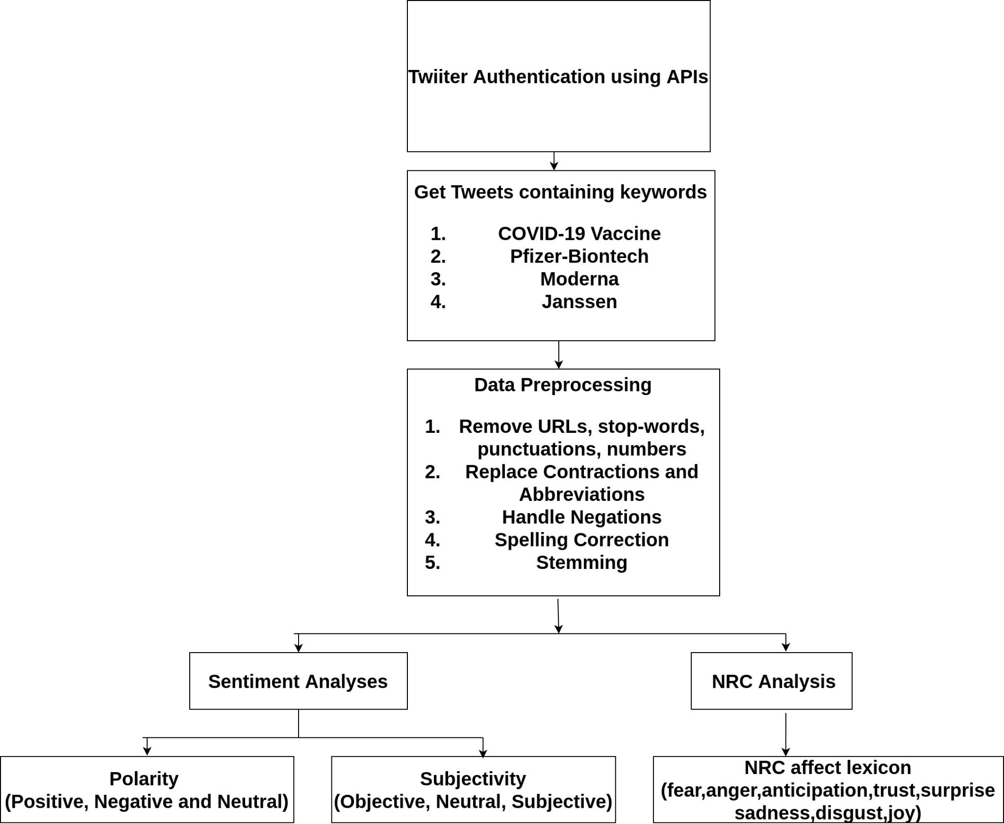
Block Diagram

Slide 3
Data Preprocessing:
Remove URLs,stopwords,numbers, punctuations, mentions
Replace Abbreviations
Eg: ai--> Artificial Intelligence, nyc-->New York City etc.
Replace contractions
Eg: ma’am-->madam, let’s-->let us
Handle Negations
Eg: ain’t→ is not, won’t-->will not
Spelling Corrections ( pyspellchecker based on Peter Norvig)
Eg: distanci -->distance
Stemming using Porter Stemmer
Sentiment Analysis(TextBlob)
Polarity
Subjectivity
NRC emotion analyses (NRCLex)
fear
anger
anticipation
trust
surprise
sadness
disgust
joy

Slide 4
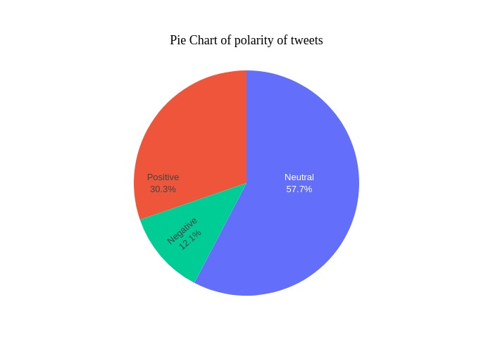
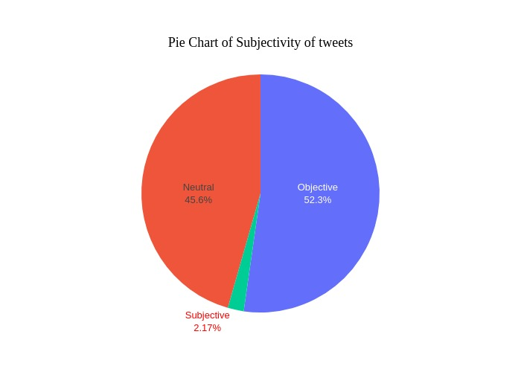
Results

Slide 5
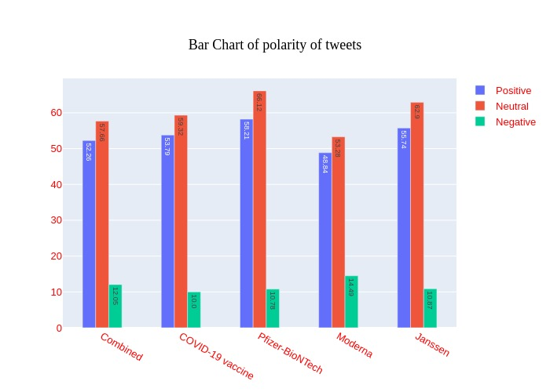
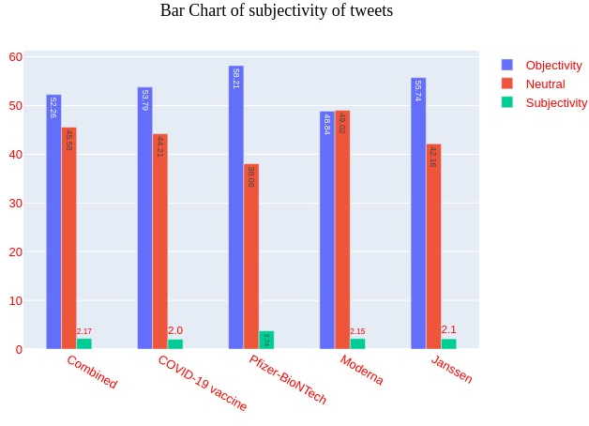

Slide 6
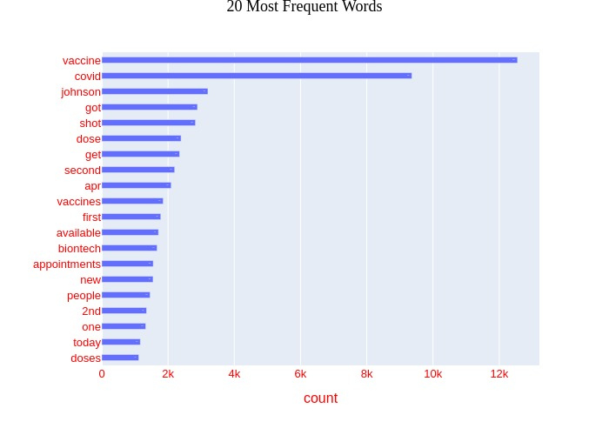
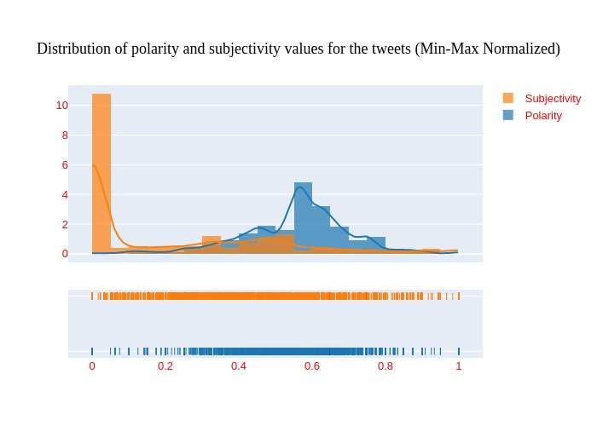

Slide 7
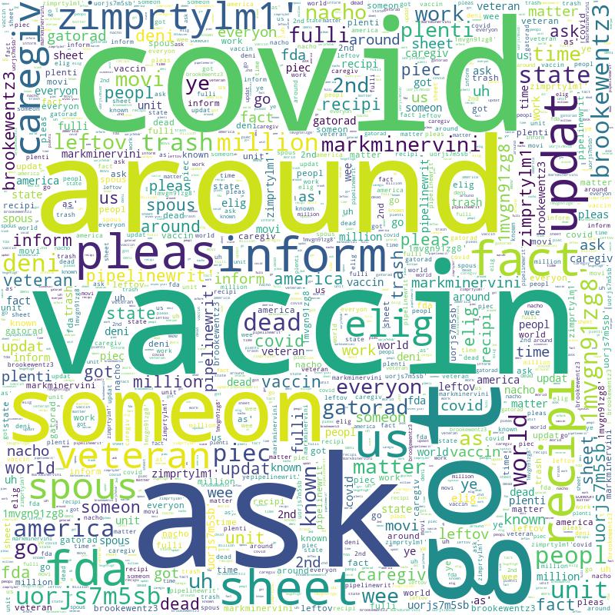
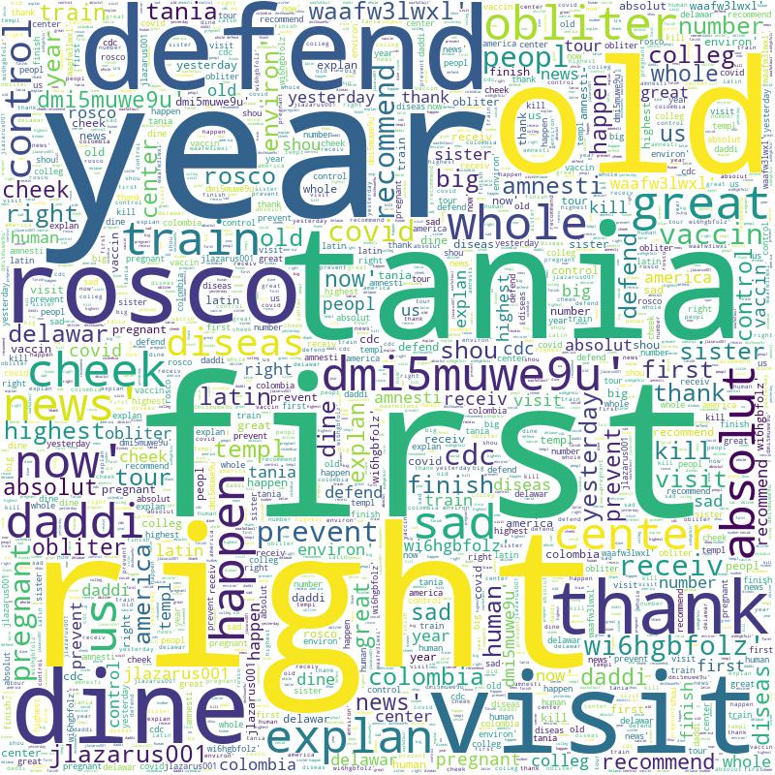
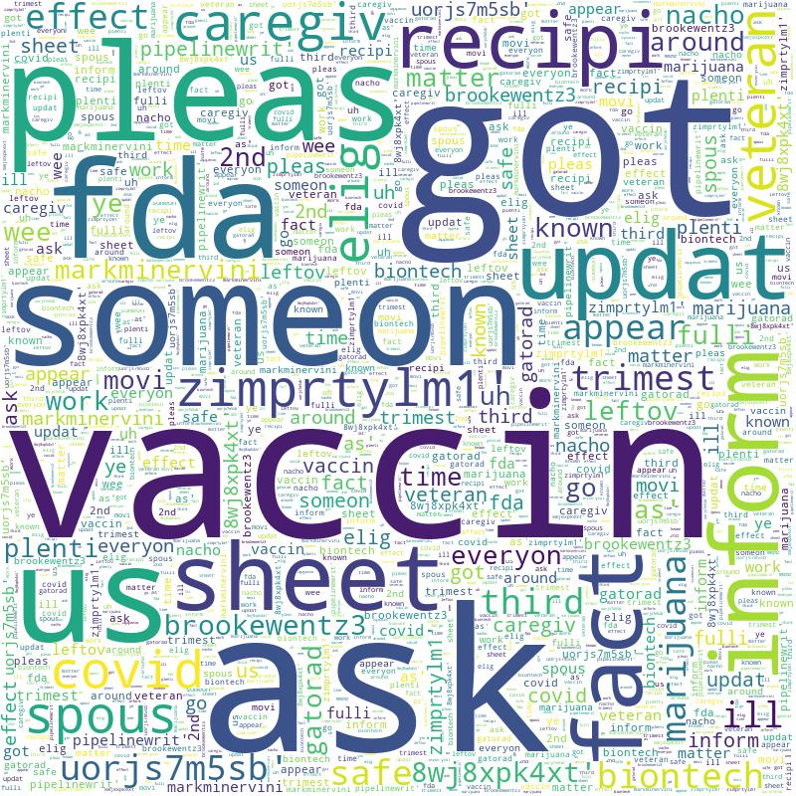
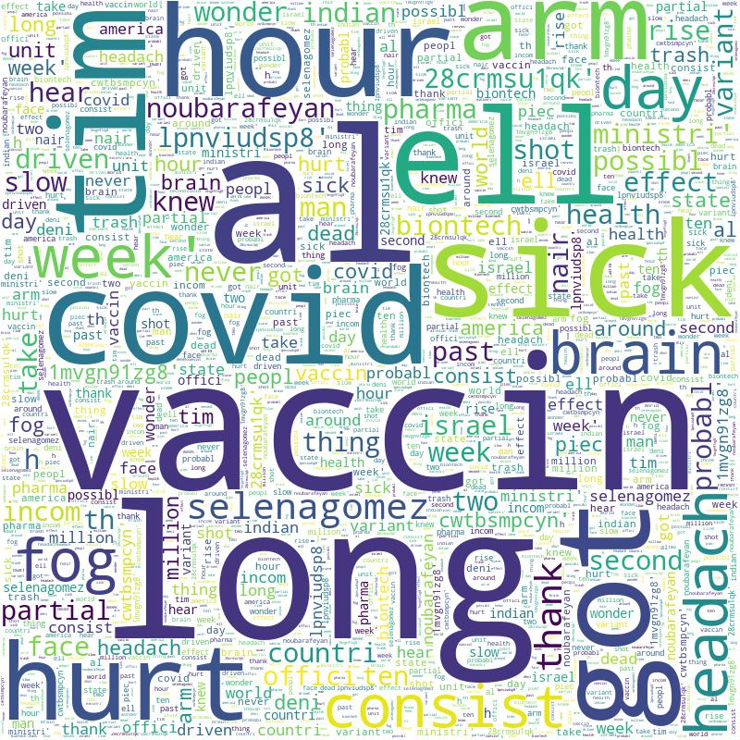
WordCloud-All Tweets
WordCloud-Positive
WordCloud-Neutral
WordCloud-Negative

Slide 8
